Slide 1
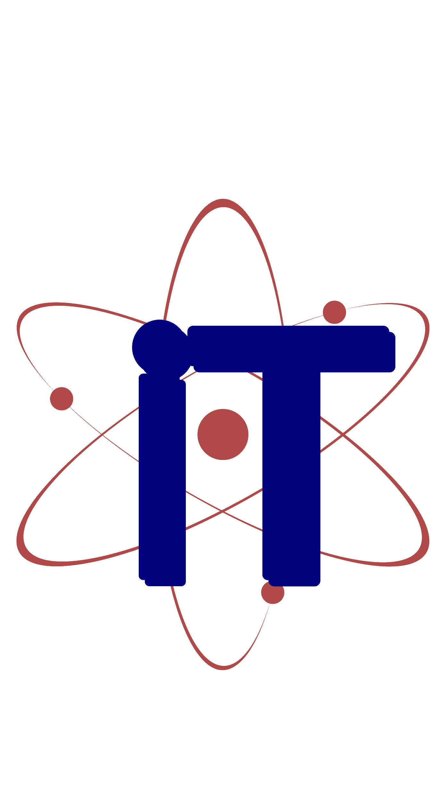

Synopsis Presentation on MindCare: AI-Driven Mental Health Insights System
Mentor Name: Presented By:
Prof.(Dr.) Prashant Lakkadwala Ananya Panwar(0827CD221010)
Bhoomika Sharma(0827CD221021)
Devanshi Joshi(0827CD221027)
Hemanshi Adlak(0827CD221036)

Slide 2
Contents
Introduction
1.1 Overview
1.2 Purpose
Literature Review
Problem Statement
Proposed Solution
Objectives
Theoretical Analysis
6.1 Block Diagram
6.2 Hardware Requirements
6.3 Software Requirements
Applications
REFERENCES

Slide 3
1. Introduction
1.1 Overview
The project uses AI and NLP to detect mental health risks in workaholic individuals by analyzing their input.
It provides personalized wellness tips, emotional risks score, and chatbot based conversations to promote self awareness and early support.
1.2 Purpose
To help overworked professionals recognize early signs of emotional and mental health decline.
To offer non-judgmental, private, and tech-driven support for users struggling with workplace stress.
To promote healthy work-life balance by suggesting practical, real-time self-care recommendations.
To contribute to reducing the stigma around mental health by using friendly AI-driven conversations and insights.

Slide 4
2. Literature Review
Sr. No. | Name of Solution/System | Features | Limitations/ Drawbacks
1. | Boosting Workplace Well-Being (2024) | AI-based chatbot for workplace well-being Employee engagement focus HR survey insights | Lacks technical depth in ML/NLP implementation More focused on engagement than real-time mental health analysis
2. | Chatbot-Based Mental Health Assessment (Viki) | Text-based chatbot for stress, burnout, insomnia Used validated psychological scales High engagement rate (64.2%) | Does not provide personalized advice Limited emotional tone detection No continuous monitoring over time
3. | TheraGen: Therapy for Every Generation | LLaMA 2 7B-powered chatbot Personalized, compassionate replies Trained on real therapy data | High computational resource requirement Limited to reactive conversations No workplace-specific stress targeting

Slide 5
3. Problem Statement
Excessive workload and inadequate emotional support in corporate and academic environments are contributing to the silent decline of mental health. Due to stigma, time constraints, and limited access to resources, individuals often overlook early warning signs of distress. There is a critical need for an intelligent, empathetic, and autonomous digital tool capable of detecting early signs of mental strain and providing timely support without relying on human intervention.

Slide 6
4. Proposed Solution
An AI-powered mental health detection system tailored for workaholics, using ML, NLP, and chatbot technologies to assess emotional well-being and provide personalized support.
User Input Interface: Chatbot-based interaction which accepts text input from user.
NLP Module: Processes text followed by preprocessing techniques such as cleaning, tokenization, and sentiment analysis.
Sentiment and Theme Detection: Classifies emotional states like burnout, stress, insomnia, self-doubt, and fatigue through keyword extraction and sentiment scoring (e.g., VADER, TextBlob).
Machine Learning-Based Risk Scoring: Utilizes models like Random Forest and Logistic Regression to predict mental health risk scores based on extracted features from user input and metadata.
Chatbot Interface: Provides empathetic, human-like conversations to deliver personalized wellness tips, self-care suggestions, and encourages journaling and reflection.
Data Visualization Module: Tracks trends in mental wellness using dashboards with graphs, heatmaps, and charts to provide actionable insights .
Feedback Loop: Continuously refines recommendations and system effectiveness through user ratings and iterative improvements.

Slide 7
5. Objectives
To develop an intelligent system that detects early signs of mental health issues such as burnout, stress, or overworking based on users' written or spoken input.
To raise awareness by providing users with personalized mental wellness tips and facts based on their emotional state.
To implement a feedback mechanism that allows users to rate the relevance of suggestions and use that data to improve future recommendations.
To track a user's emotional and mental health patterns over time through visualization tools like charts and progress bars.
To create a conversational, empathetic interface (optional chatbot-style) that encourages users to reflect on their feelings in a comfortable and non-judgmental way.

Slide 8
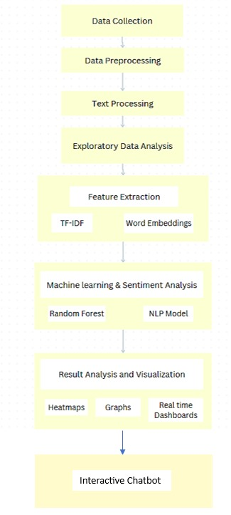
6. Theoretical Analysis 6.1 Block Diagram

Slide 9
3.2 Hardware/Software Design
Hardware Requirements:
RAM: Minimum 8GB, recommended 16GB or more for handling large datasets efficiently.
Storage: At least 50GB of free disk space.
Software Requirements:
1. Operating System: Windows 10/11 , Linux.
2. Programming Language: Python for model development, HTML, CSS, JS.
Libraries & Frameworks:
Natural Language Processing (NLP) : NLTK, TextBlob, VADER, TF-IDF.
Machine Learning Models : Logistic Regression (from scikit-learn), Random Forest Classifier
Data Analysis : Pandas, NumPy.
Data Visualization : Matplotlib, Seaborn, Plotly.
Web App Framework : Streamlit.
IDE / Code Editors : Jupyter Notebook, Google Colab

Slide 10
9. Applications
Corporate HR Teams: Empower organizations to monitor and enhance employee mental well-being, reduce burnout, and foster a productive work environment using actionable insights.
Remote Work Platforms: Integrate as a wellness feature to help remote workers maintain a balance between work demands and mental well-being.
Individual Use: Enable freelancers and solo entrepreneurs to conduct daily emotional check-ins, track stress levels, and adopt personalized self-care practices.
Healthcare Providers: Assist therapists and counselors by offering supplementary tools for tracking patient mental health trends and enhancing care delivery.
Workplace Productivity Platforms: Enhance existing tools like project management software with mental health analytics for better team dynamics and reduced stress.
Government & Non-Profits: Utilize the system to implement large-scale mental health awareness programs and support underprivileged communities with scalable interventions.

Slide 11
GitHub Link
https://github.com/Ddevanshii10/MindCare

Slide 12
REFERENCES
[1] World Health Organization, “Mental health in the workplace,” [Online]. Available: https://www.who.int/teams/mental-health-and-substance-use/promotion-prevention/mental-health-in-the-workplace
[2] P. Sharma and M. Gupta, "Boosting Workplace Well-Being Using AI Chatbots: A Corporate Wellness Approach," Proc. of Intl. Conf. on Human-Centered AI, pp. 45–52, 2024
[3] A. Banerjee and R. Singh, "Viki: A Chatbot-Based Framework for Mental Health Monitoring," Journal of AI and Mental Health, vol. 10, no. 2, pp. 101–110, 2023.
[4] R. Kumar and N. Ali, "A Review on Large Language Models for Workplace Well-being Applications," AI Trends in Healthcare Review, vol. 6, no. 4, pp. 200–210, 2024.
[5]Gupta, S., "Mental Health Matters: A Tech Industry Analysis," Kaggle. Available: https://www.kaggle.com/code/soorajgupta7/mental-health-matters-a-tech-industry-analysis/input.

Slide 13
Thank You
Queries ?

